Slide 1




ONLINE
TRAVELLING
SYSTEM
Submitted By
Name: Akanksha Uniyal
University Roll No: 2021064
Mentor Name: Dr Rishi Kumar
Designation: Assistant Professor

Slide 2




INTRODUCTION
Welcome to our innovative online travel system! Developed entirely using Java Swings and JDBC, our platform offers a seamless, user-friendly experience for booking train, bus, and cab tickets from a single interface.
With a focus on simplicity and efficiency, our system enables users to securely login and effortlessly input all necessary details for their travel bookings. The integration of Java Swings ensures an intuitive and visually appealing interface, while JDBC facilitates smooth connectivity to our MySQL database, ensuring secure data storage and retrieval.

Slide 3



PROBLEM STATEMENT
Traditional travel booking methods pose challenges such as time inefficiency and limited options. Our project addresses these issues by offering a centralized Online Traveling System, ensuring real-time updates, ease of use, and secure booking. The objective is to revolutionize the travel booking experience, aligning it with the contemporary needs of today's travelers.

Slide 4








METHODOLOGY
1) SOFTWARE SPECIFICATIONS
MYSQL Workbench: 8.0 CE
Operating System:
Microsoft Windows 10
JDK 20
Apache NetBeans:
IDE 19
IDE 19

Slide 5
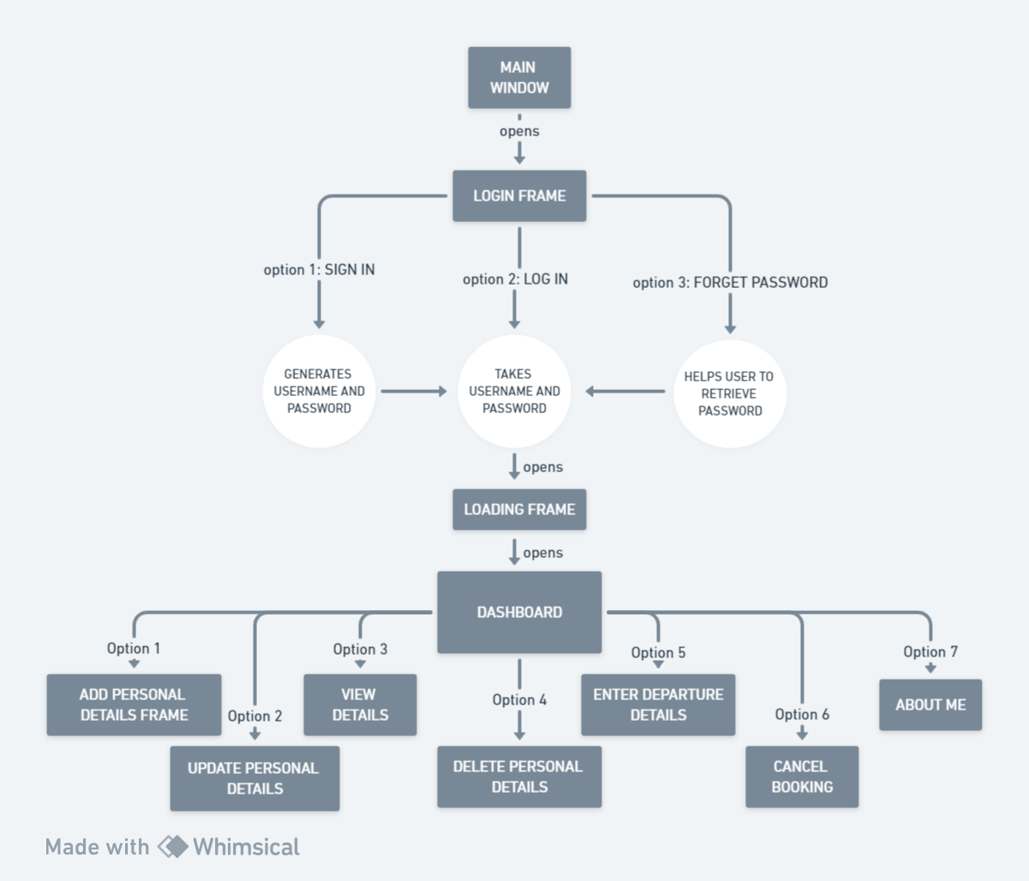
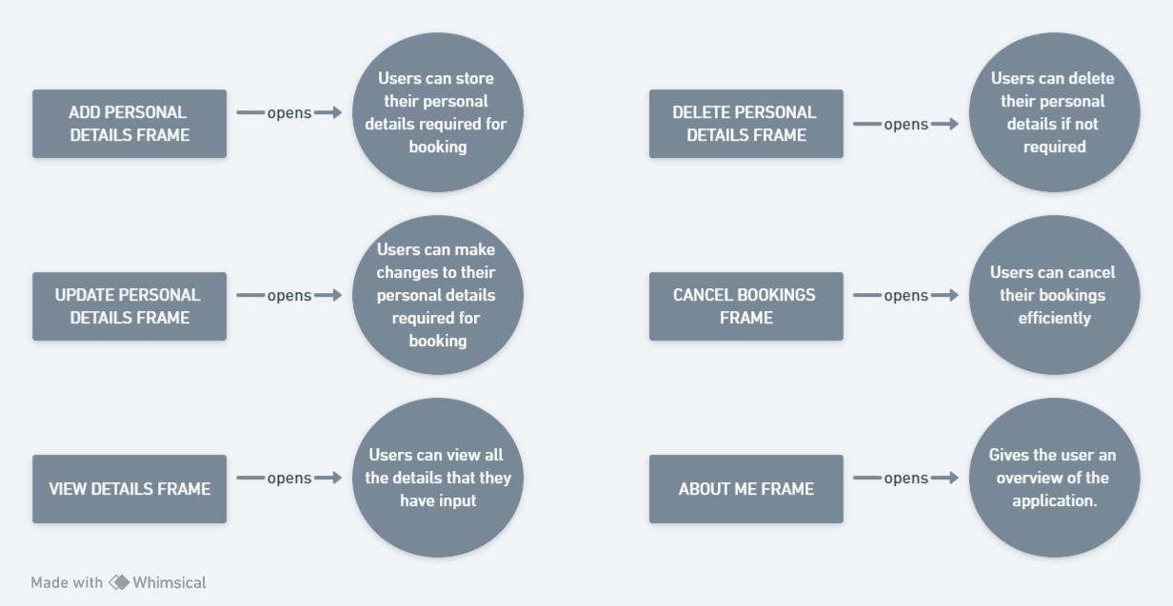
2) DESIGN
MYSQL Workbench: 8.0 CE
Operating System:
Microsoft Windows 10
JDK 20
Apache NetBeans:
IDE 19
IDE 19

Slide 6
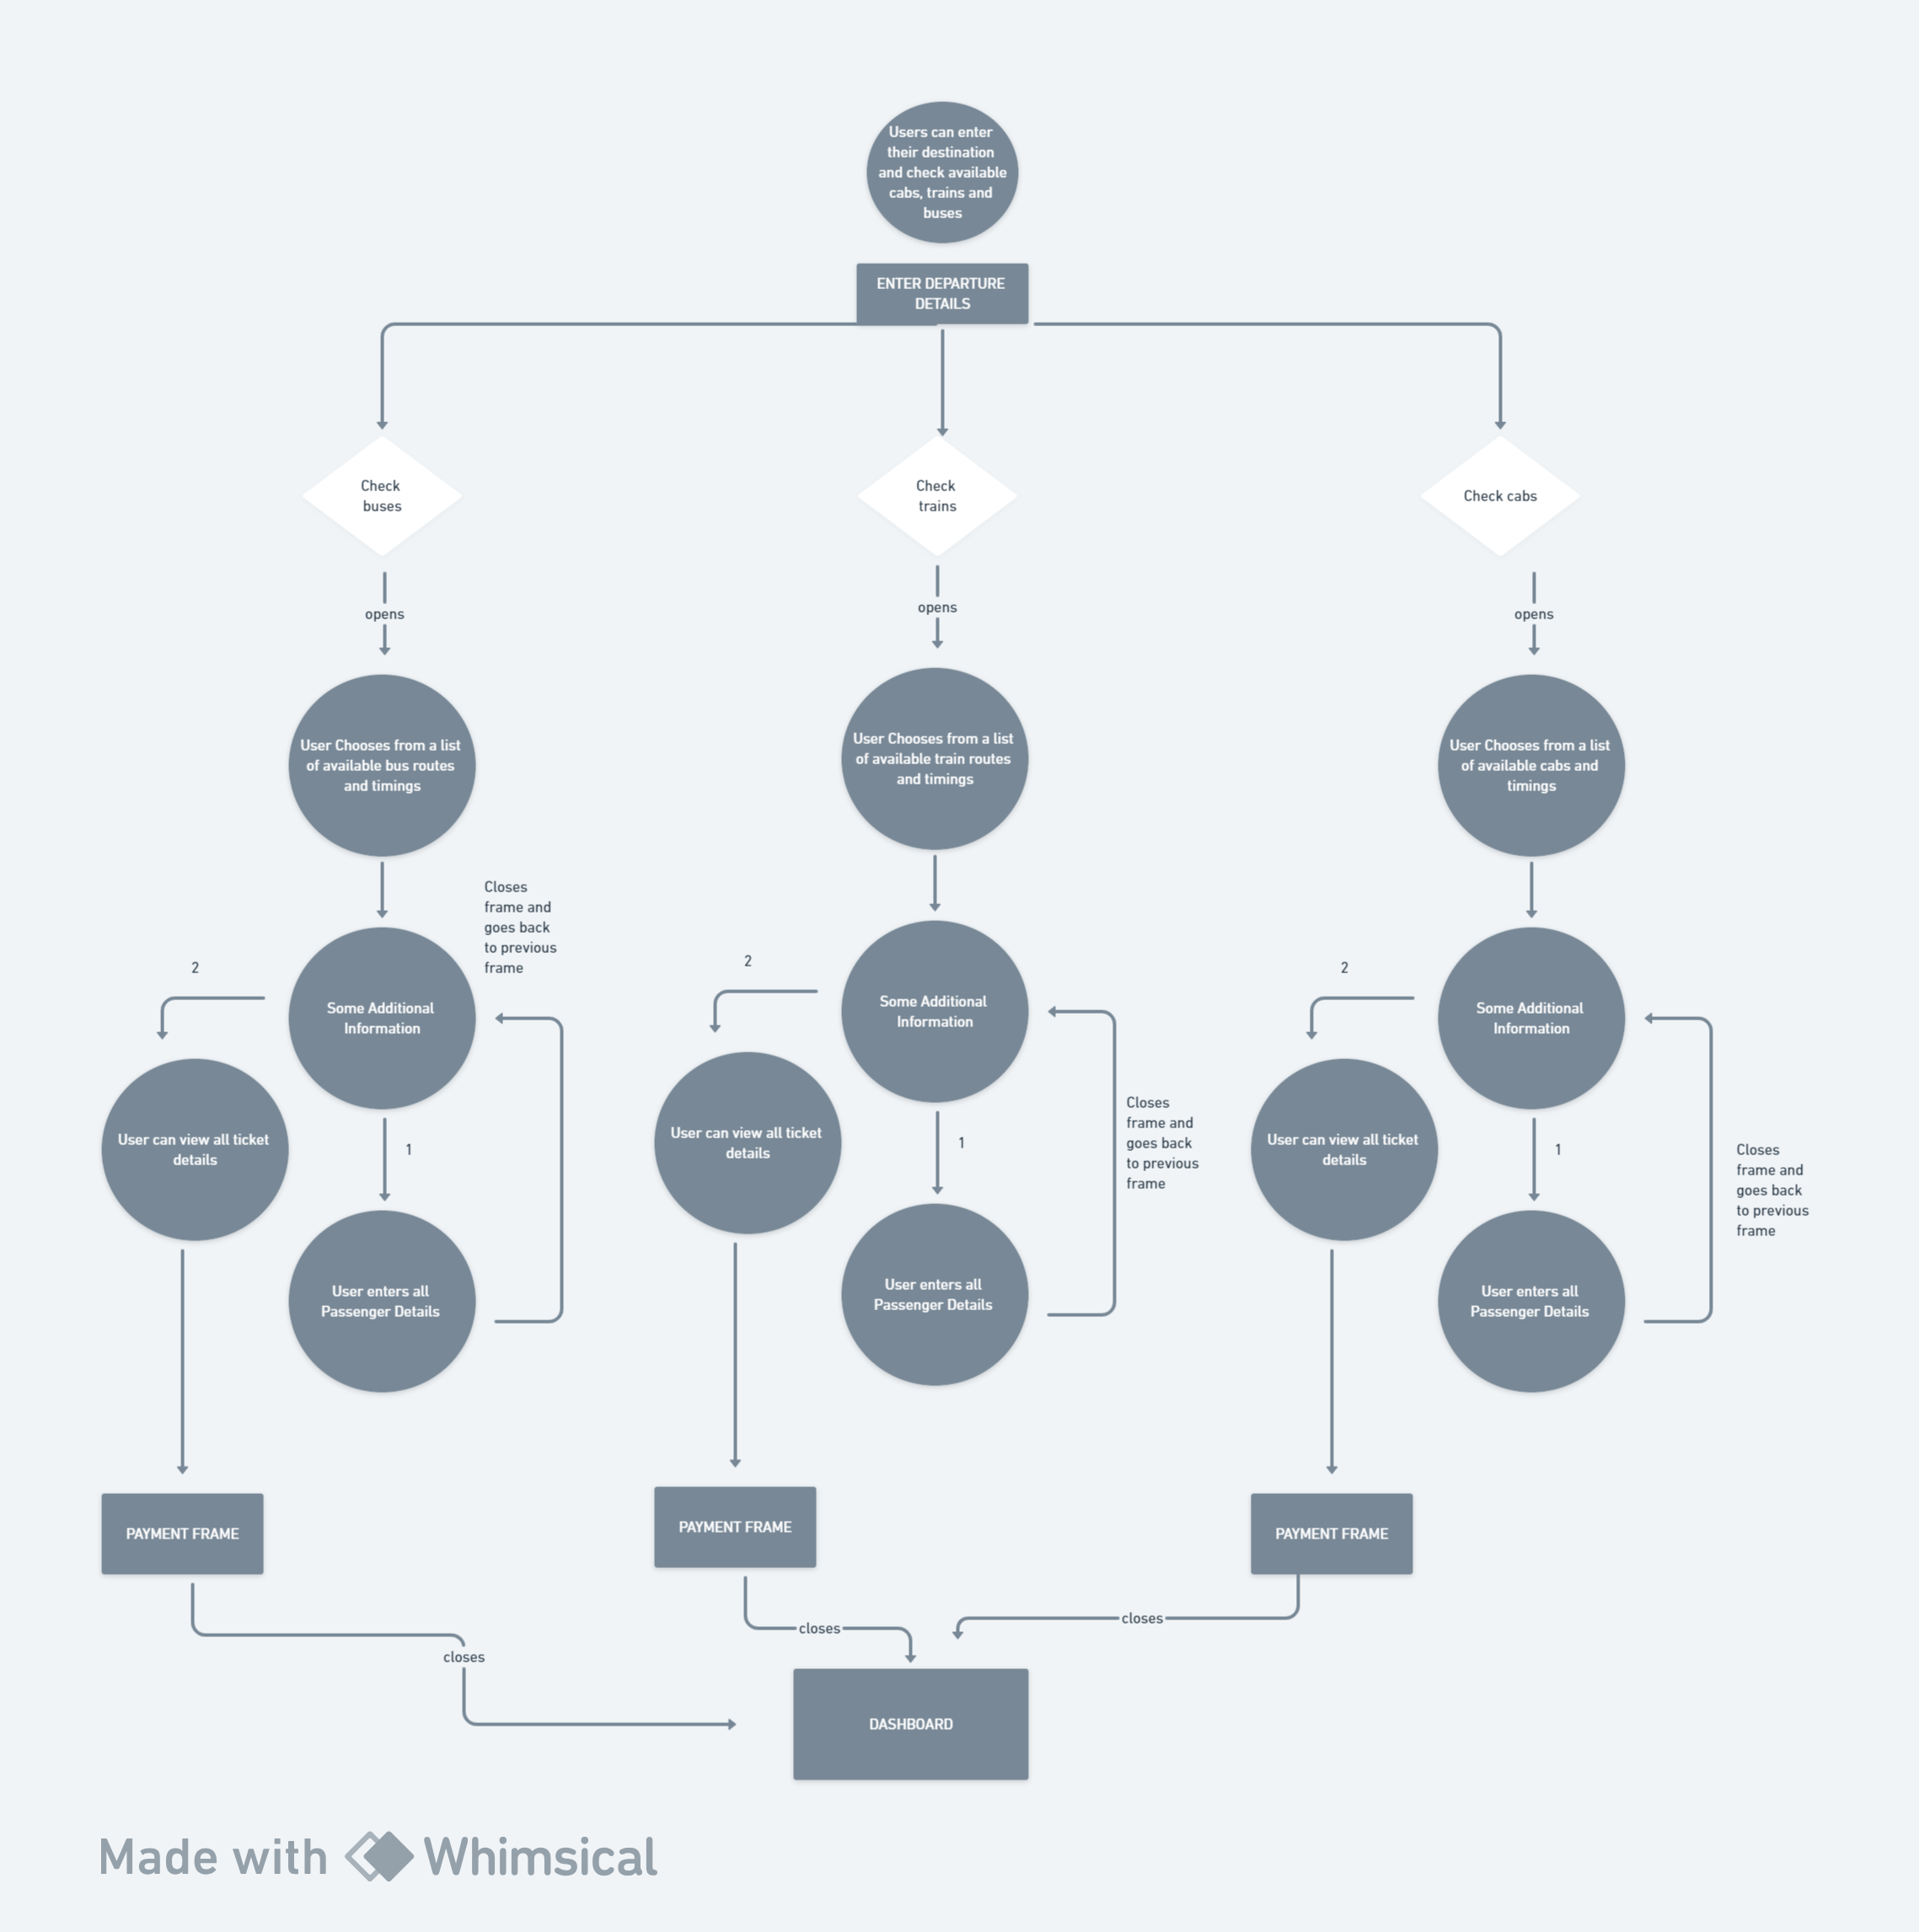
MYSQL Workbench: 8.0 CE
Operating System:
Microsoft Windows 10
JDK 20
Apache NetBeans:
IDE 19
IDE 19

Slide 7

Test cases No. | Test case | Input Data | Steps to execute the test case | Expected Result | Actual Result | Pass/Fail
1 | Login Screen | Wrong username or password | After entering the data click on the login button | A proper message indicating the error should appear and the user should be redirected to login screen. | A message was displayed saying Invalid username or password | Pass
2 | Insertion | If any field was entered, say passenger details | After entering the data click on the enter button | A proper message should appear and the user should be redirected to customer screen. | A message was displayed saying all passenger details entered | Pass
3 | Deletion | If a field was to be deleted | After clicking on the delete button | A proper message should appear and the user should be redirected to customer screen. | A message was displayed saying All details deleted successfully | Pass
4 | Update | If any field needs to be changed | After entering the data click on the update button | A proper message should appear and the user should be redirected to update customer screen. | A message was displayed saying All details updated successfully | Pass
RESULT
AND
DISCUSSION
TESTING

Slide 8

CONCLUSION AND FUTURE WORK
In conclusion, the Online Traveling System project represents a significant step forward in modernizing and simplifying travel arrangements. By leveraging Java Swing and MySQL, we have created a user-friendly platform for booking train, cab, and bus tickets. This initiative addresses the limitations of traditional booking methods and strives to enhance overall user experience. The successful implementation of this project paves the way for a more efficient and streamlined approach to travel planning, meeting the contemporary demands of today's users.

Slide 9

Future Work:
The Online Traveling System project lays the foundation for future enhancements. Potential avenues include integrating artificial intelligence for personalized recommendations, expanding transportation modes, and ensuring compatibility with emerging technologies. Continuous updates will drive the platform's evolution, ensuring it remains user-centric and adaptable to changing needs.

Slide 10
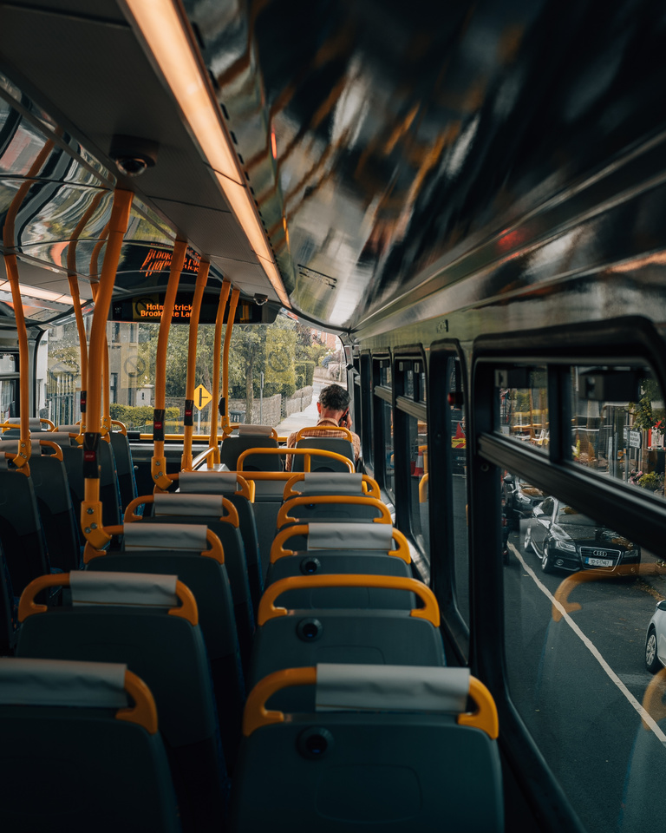
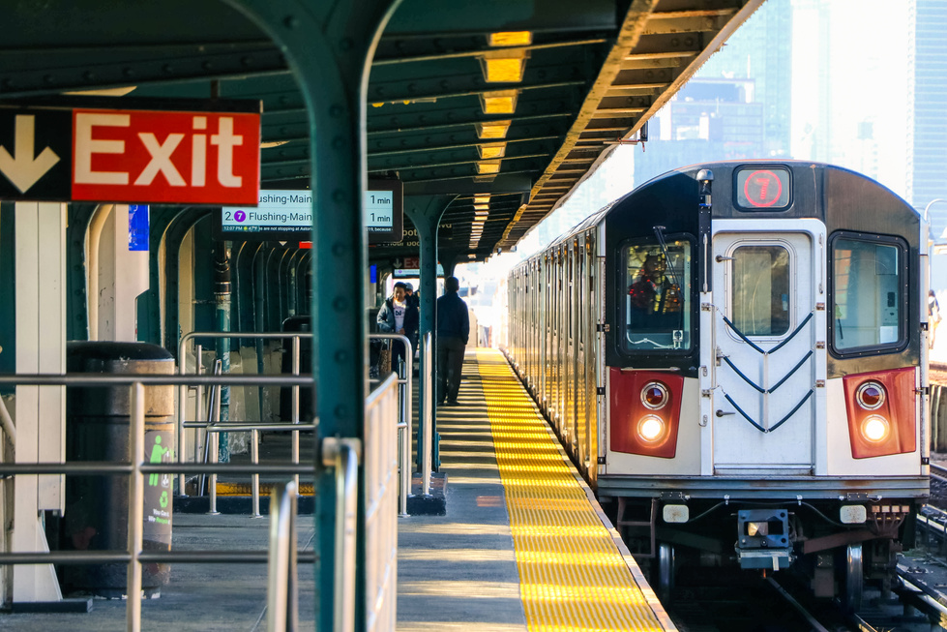


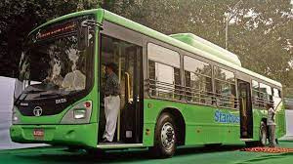

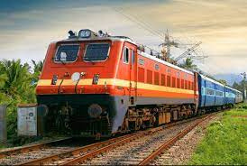
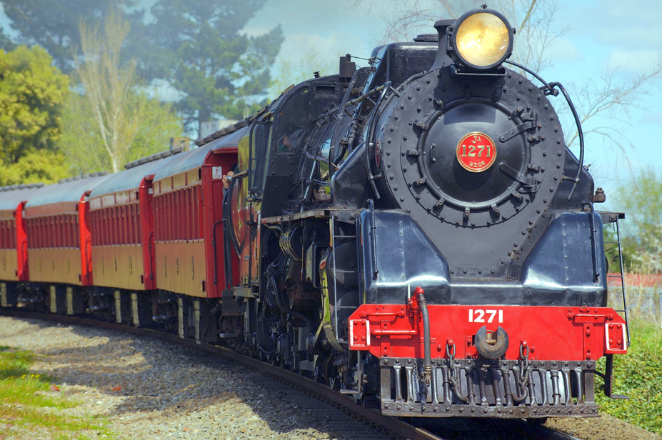
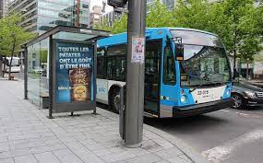
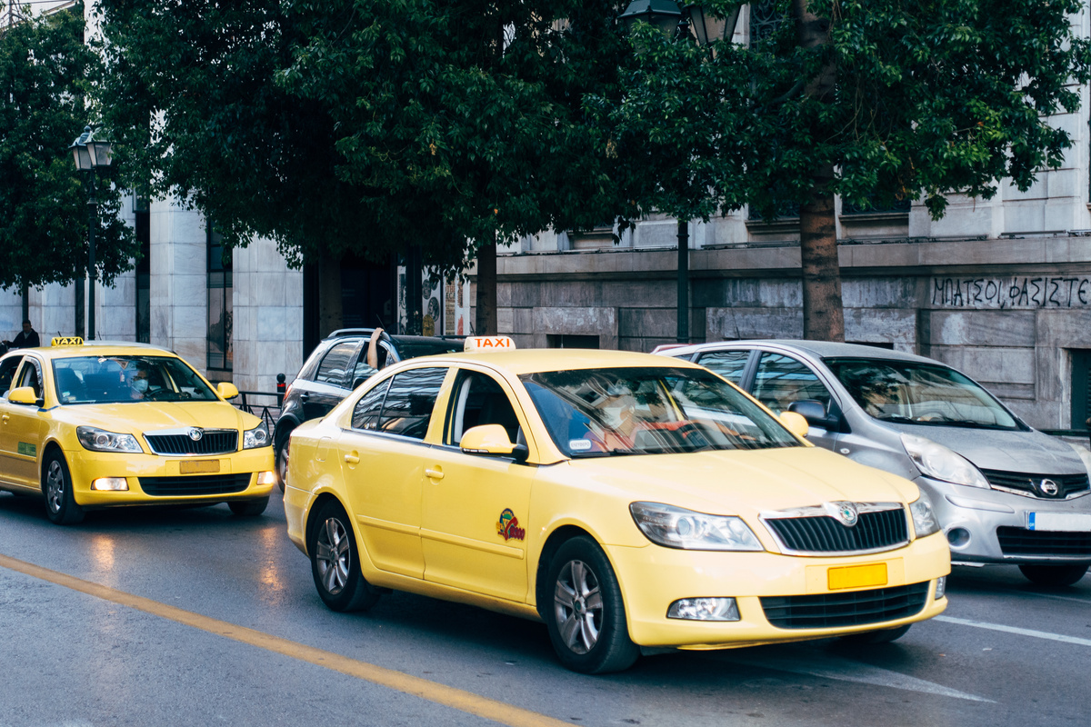
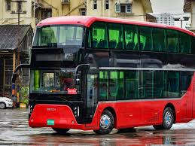
THANK'S FOR WATCHING

